Slide 1
Forecasting image processing sun position correction

Slide 2
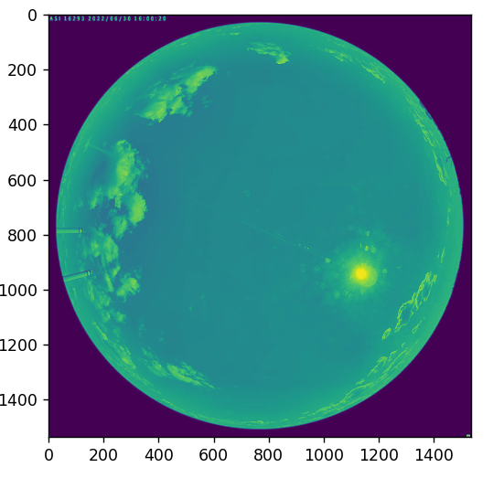
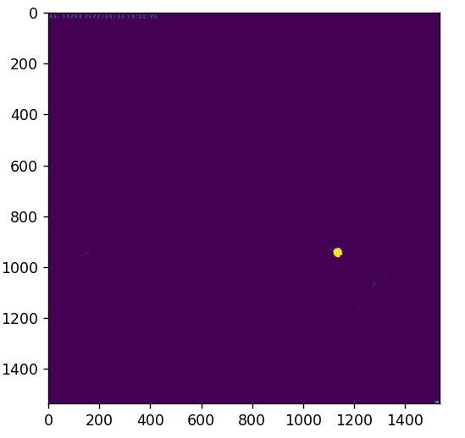
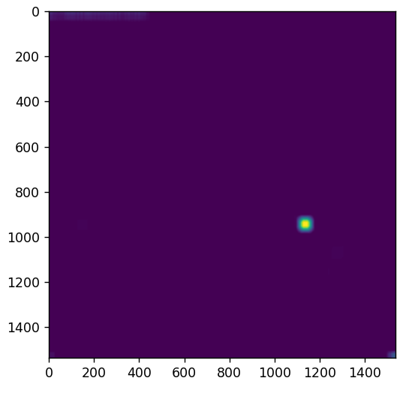
Finding the sun

Slide 3
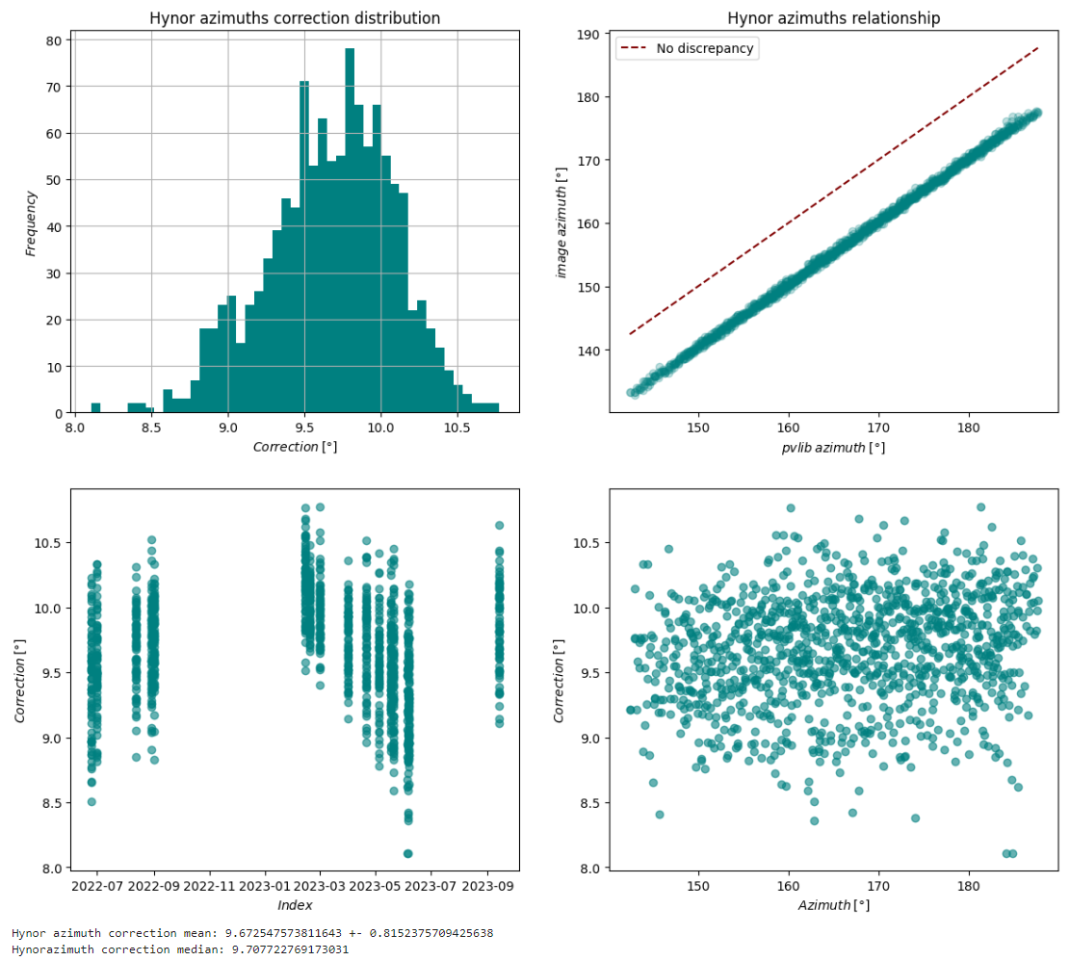
Correcting azimuth
Hynor
  Mean 9.67 +- 0.81
  Median 9.71

Slide 4
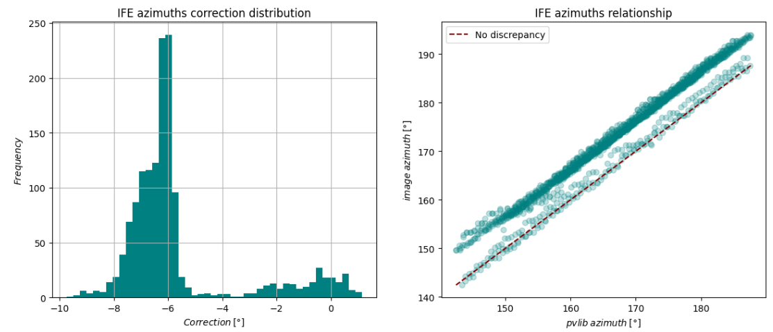
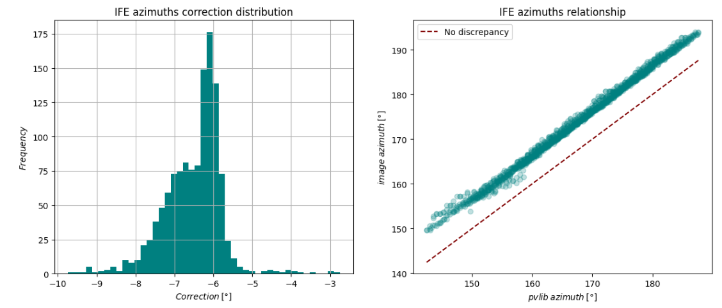
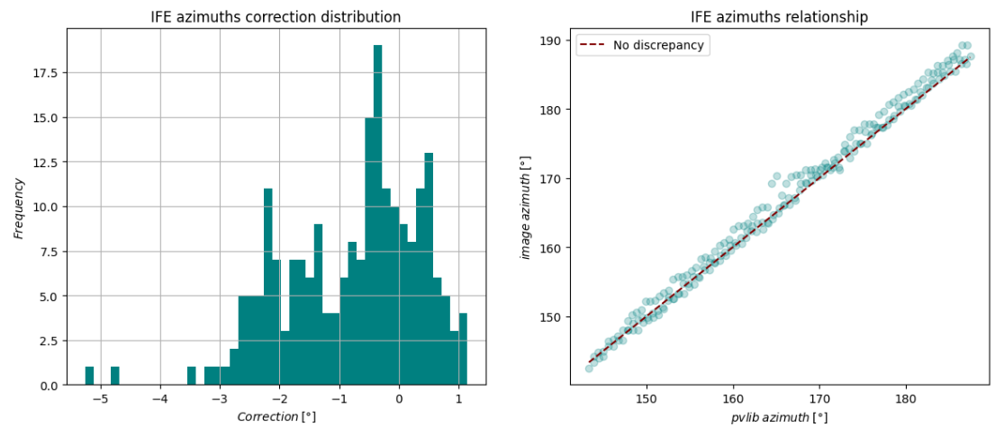
IFE azimuth
After and before 09-2022
  Before -0.8 +- 2.2
  After -6.5 +- 1.46

Slide 5
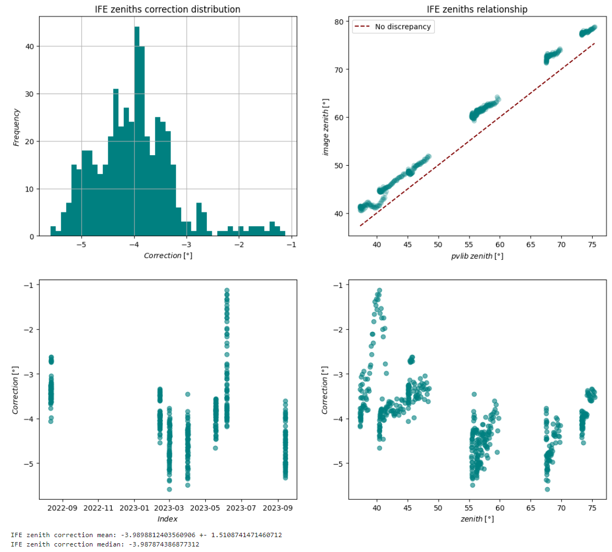
Correcting Zenith
With implementation of only a part of the image being a fisheye image, increasing the proportional radius, making the calculated zenith higher.

Slide 6
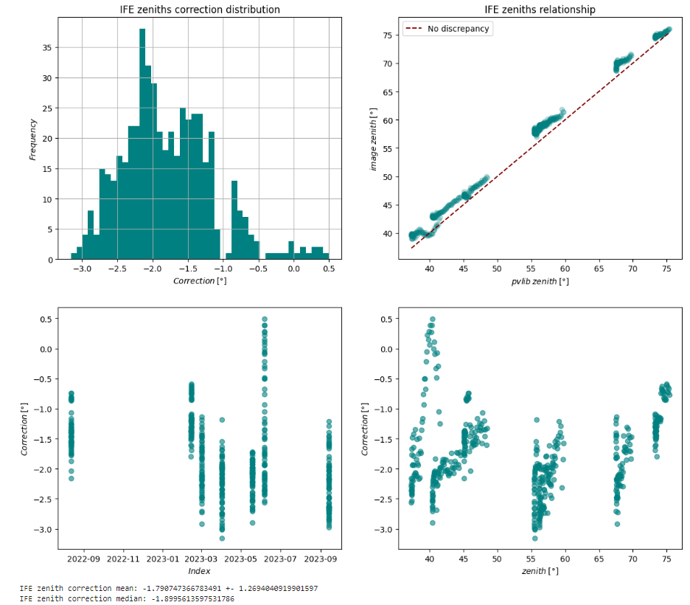
With the whole image 0-90 degrees

Slide 7
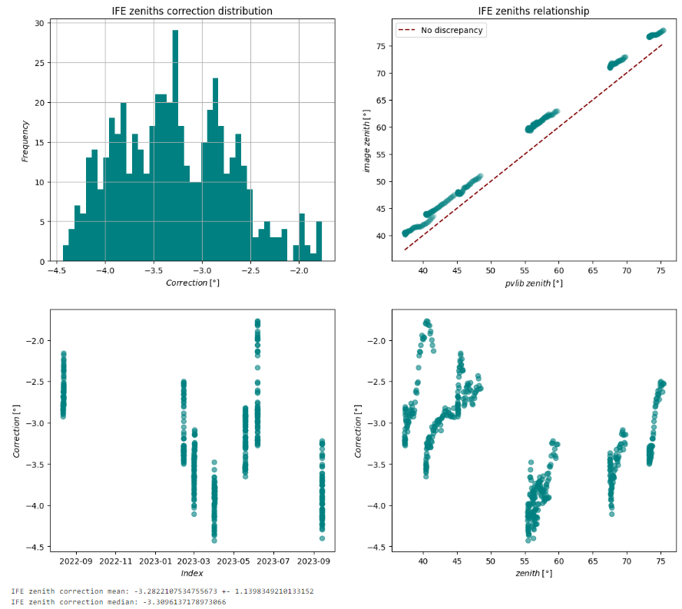
Using center of mass algorithm for sun finding and going 0-92 degrees for whole image, ignoring that the fisheye doesn’t take up the whole sensor

Slide 8
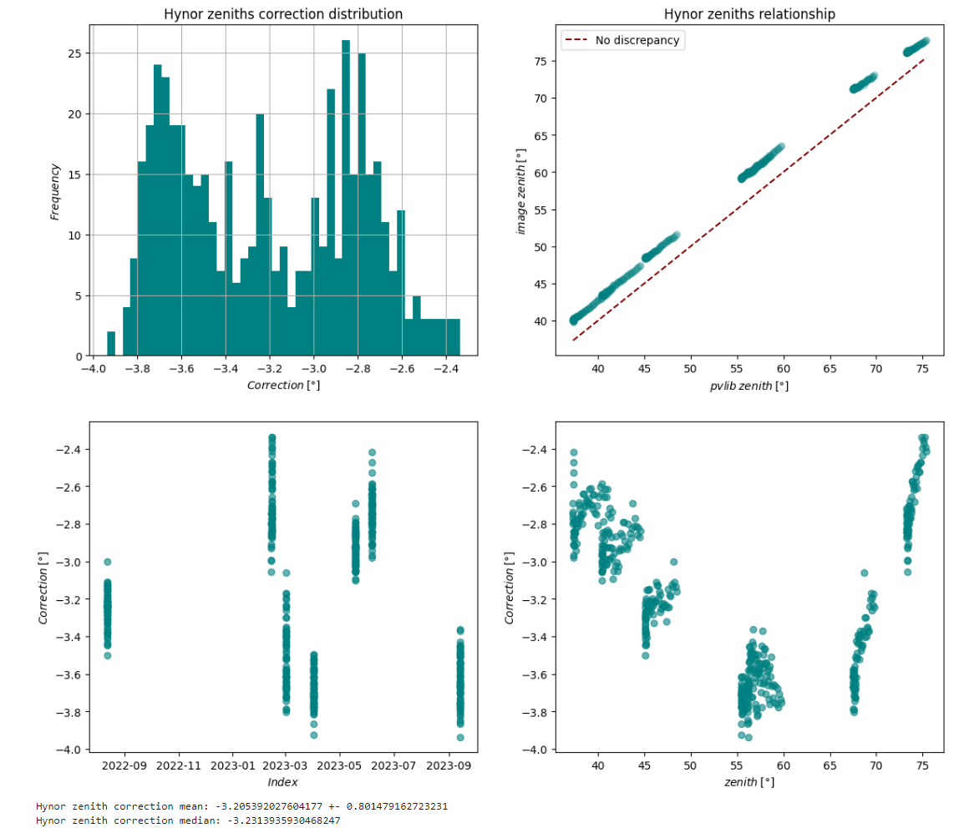
Hynor zenith correction

Slide 9
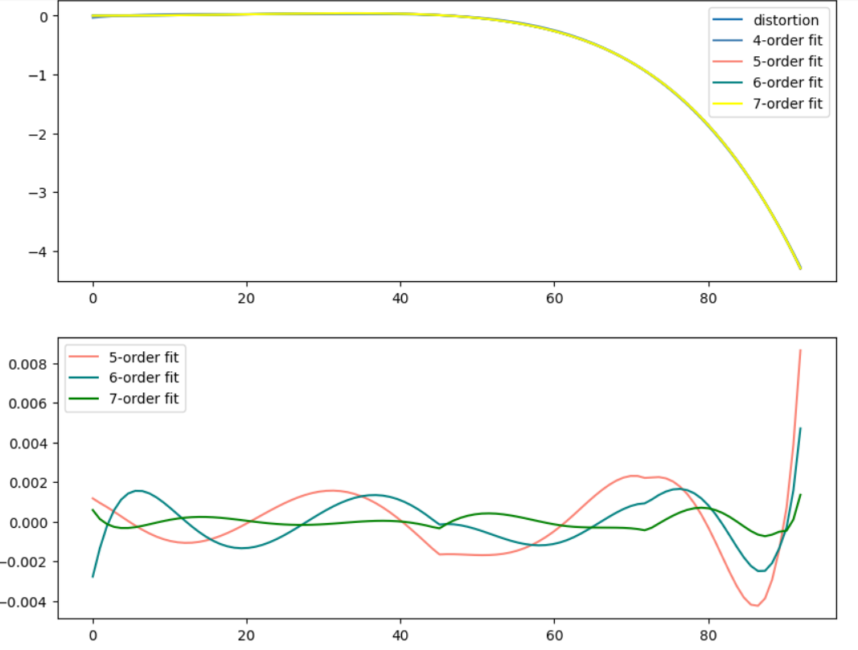
Zenith lens distortion correction

Slide 10
Cloud Base Height
Use epipolar geometry to gain stereographic vision from the two cameras
With this dep

Slide 11
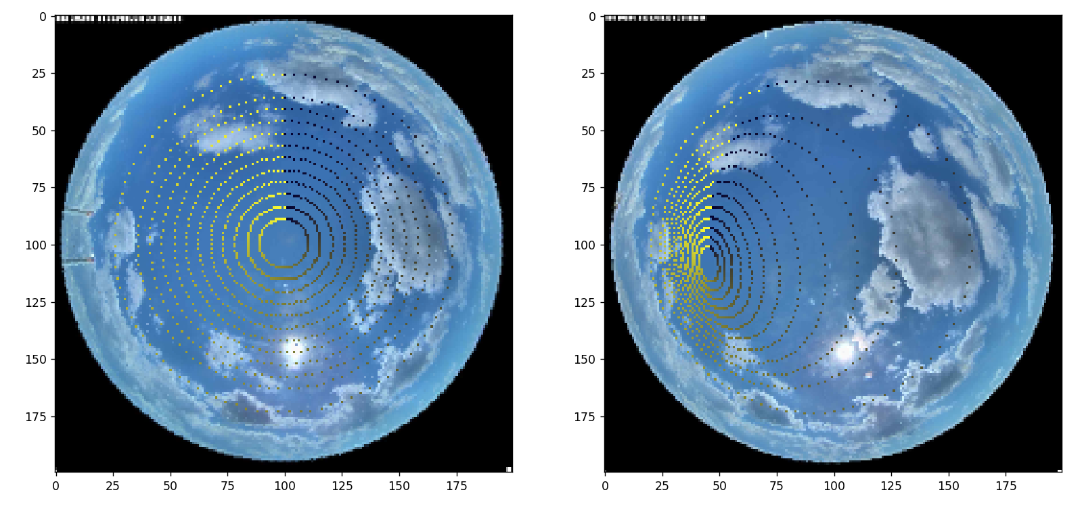
Stereographic vison test, height = 1000m

Slide 12
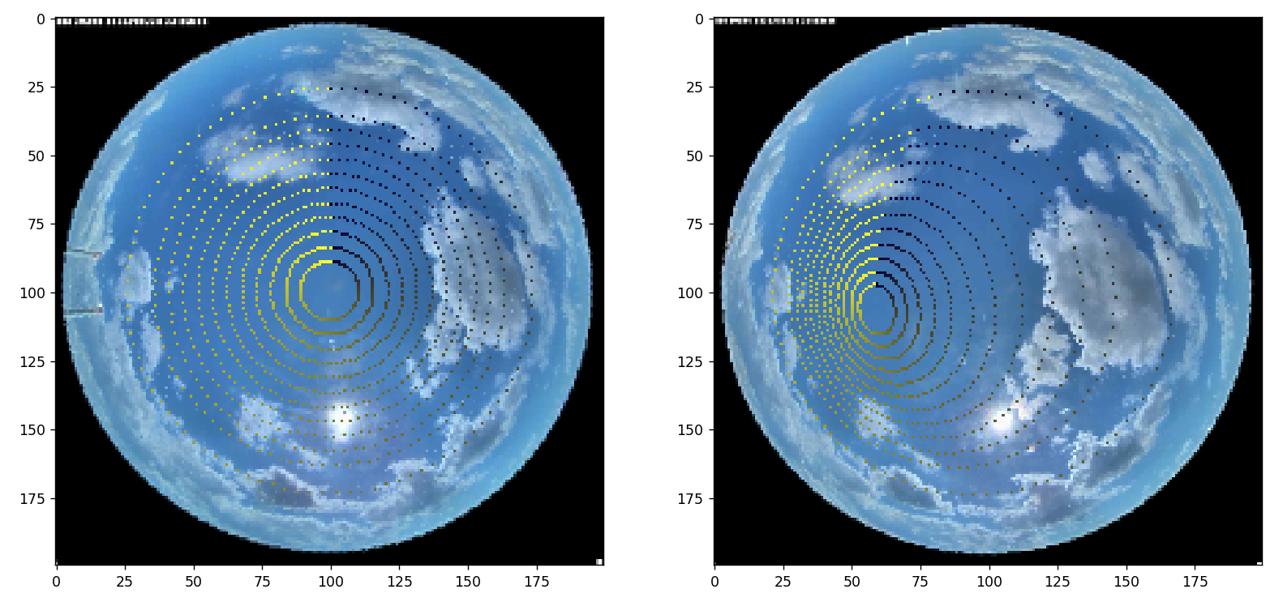
Height = 1500m

Slide 13
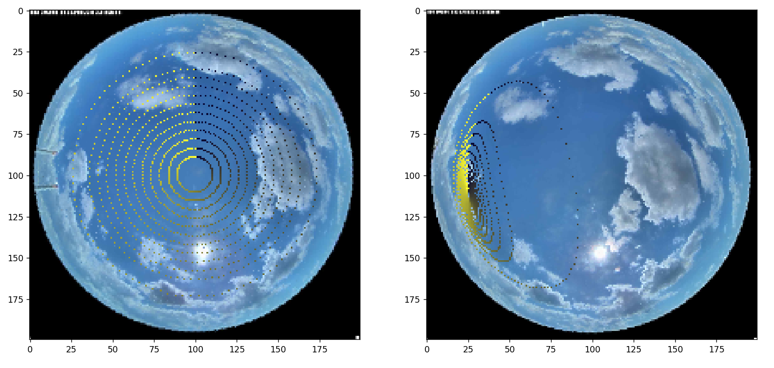
Height = 500m

Slide 14
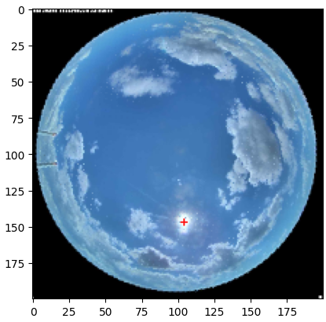
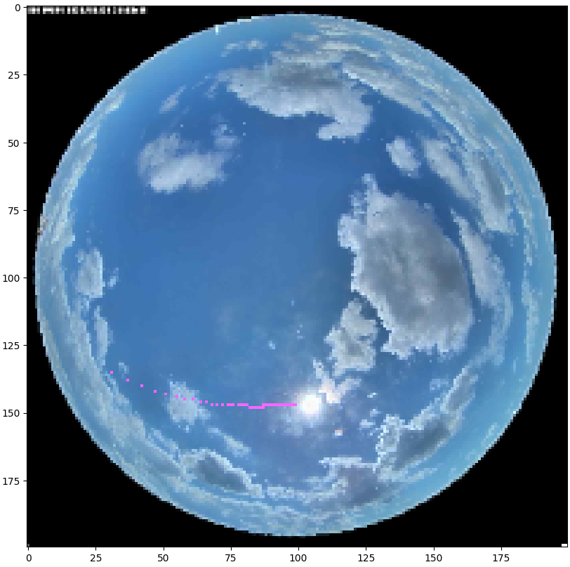
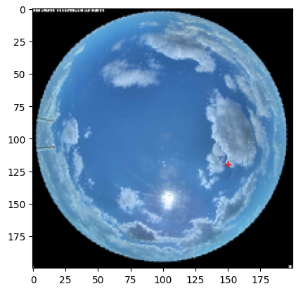
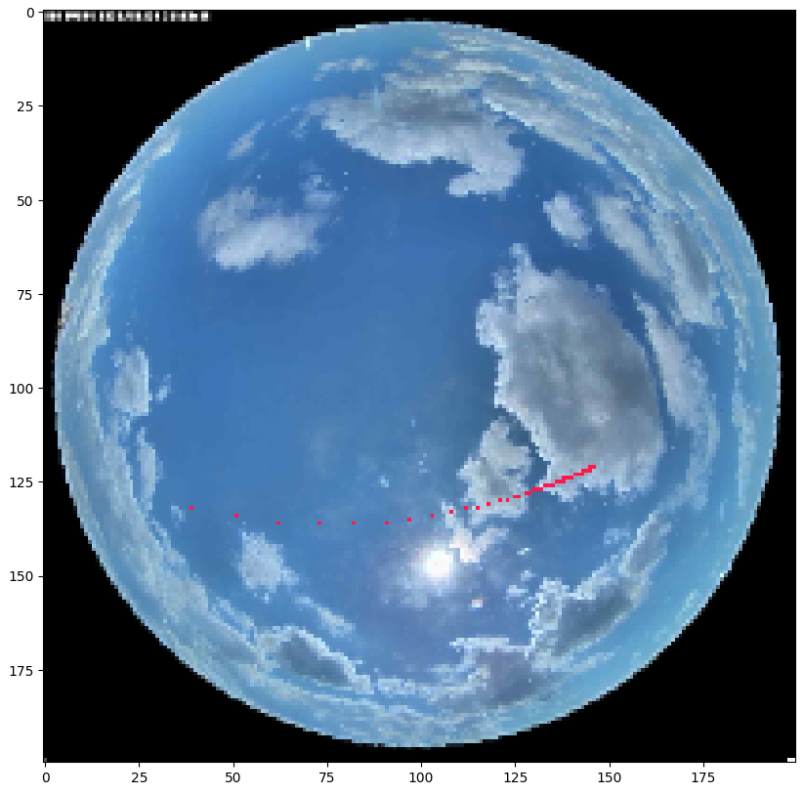

Slide 15
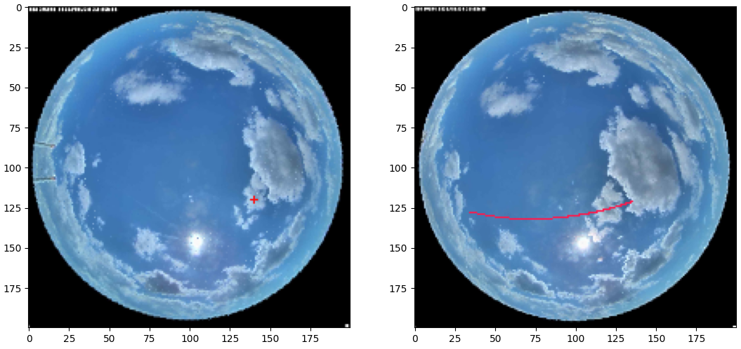
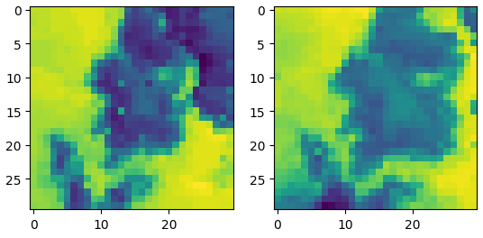
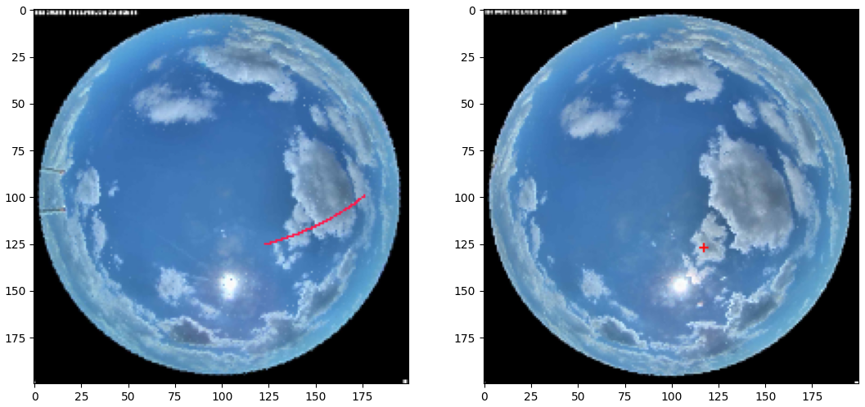
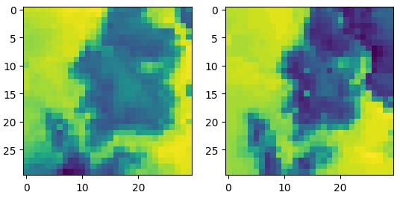

Slide 16
